Slide 1
Gaming Research Marketing Deck
Started since July 8, 2015

Slide 2
Outline
1) Major Gaming Companies
2) Top Grossing Games
3) Top Free Games
Note: All rankings are determined in the “Games” ranking from appannie under “Store Stats” in “Market Data” section.
Note: Relevant sources are added in the “Notes” section.

Slide 3
1) Major Gaming Companies
A. LINE
B. AsiaSoft
C. SiamGame

Slide 4

A. LINE

Slide 5

A. LINE
a. Brief Introduction
b. Case Study of Successful Games
c. Case Study of Non-successful Games
d. Conclusion

Slide 6
LINE a. Brief Introduction
Developer | LINE Cooperation
Founded | September 4, 2000
Operating System | iPhone, Android, Windows, Blackberry, Mac OS X
Type | Instant Messaging Client
Headquarter | Tokyo, Japan
Features | Free voice and video calls Group Chats World’s largest collection of Unique stickers
Revenue | ¥12,596,190,000 (2013-14)

Slide 7
LINE b. Case Study of Successful Games
1. LINE Let’s Get Rich เกมเศรษฐี
2. LINE Bubble 2
3. LINE Football League Manager
4. LINE Rangers
5. LINE Cookie Run

Slide 8



LINE - Case Study of Successful Games 1. LINE Let’s Get Rich เกมเศรษฐี Introduction
Free Ranking | Thailand: 9 (iOS), 10 (Android)
Gross Ranking | Thailand: 1 (iOS), 2 (Android)
First Version Released | July 3, 2014 – over 10 millions download after the game is launched in one month in Thailand.
Brief description of game | A mobile version of the classic game of monopoly Easy to play –roll the dice, construct landmarks, and make the opponent(s) bankrupt.
Target audience | Age: 18 – 35 Gender Ratio: 50 % Male, 50 % Female
Unique Selling Position | Unique-character & landmarks named after tourism sites Strategical (which item to use, roll odd/even dice, where to land next) [spending money does not guarantee victory]

Slide 9
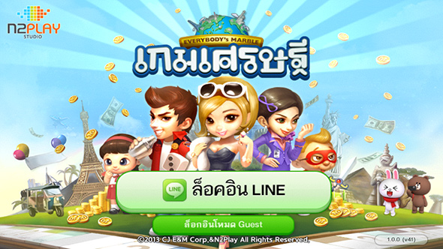
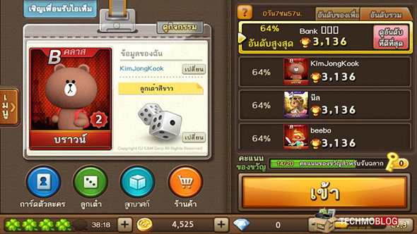
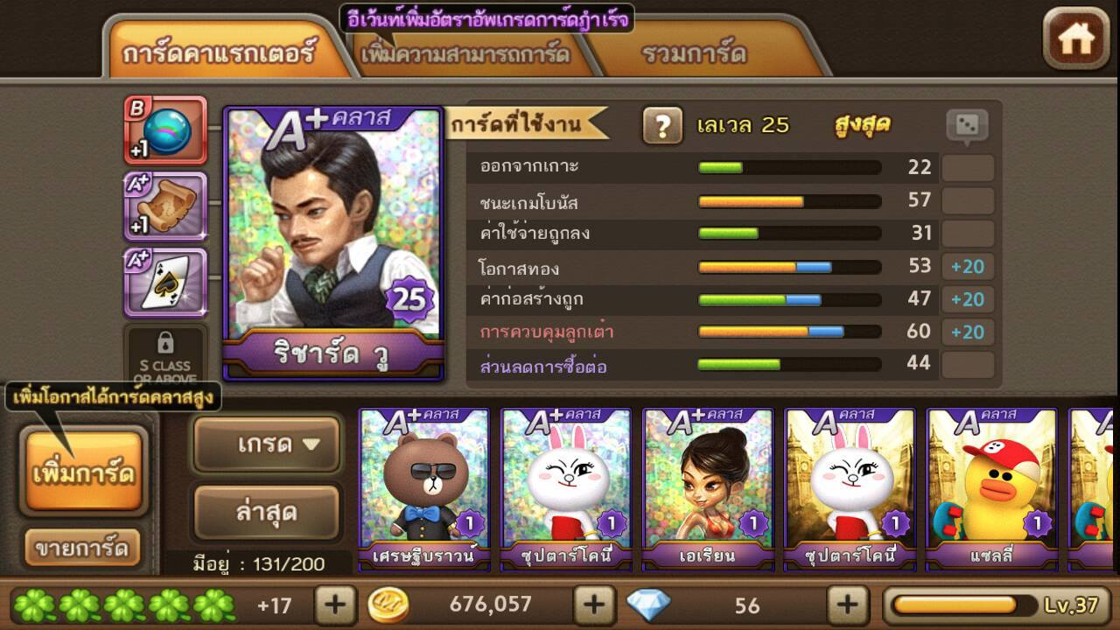
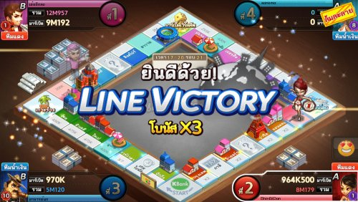
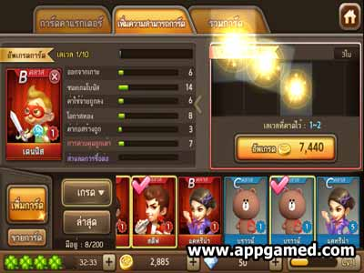
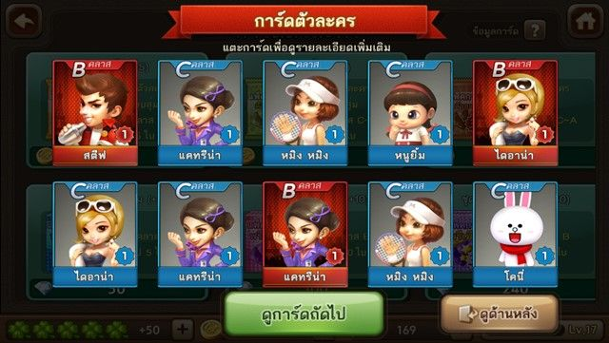
LINE - Case Study of Successful Games 1. LINE Let’s Get Rich เกมเศรษฐี Game’s Screenshot
First page
Main Menu
Character’s detail
During in-game was playing
Upgrade card character
Character card deck

Slide 10
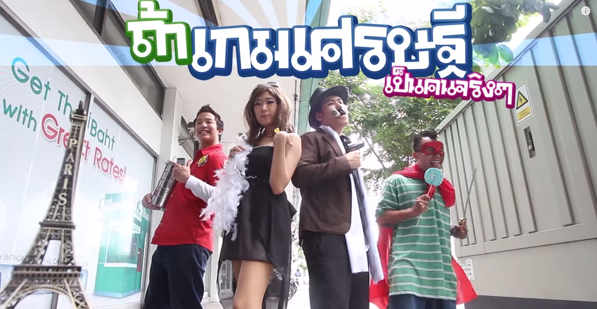
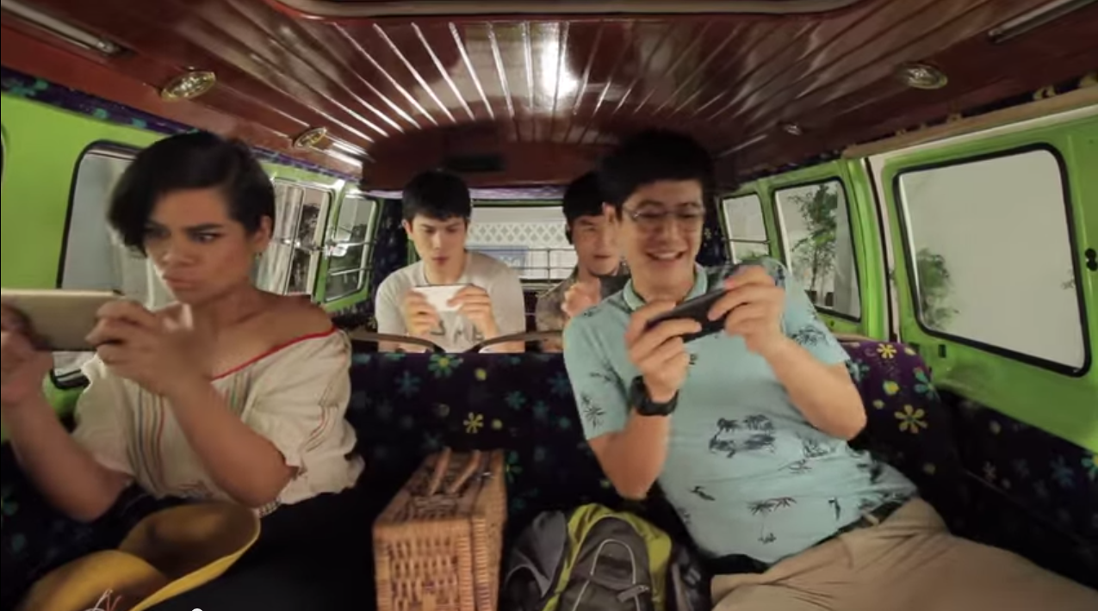
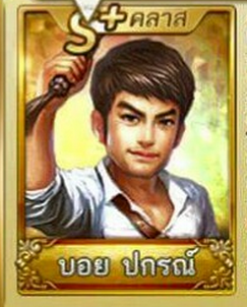
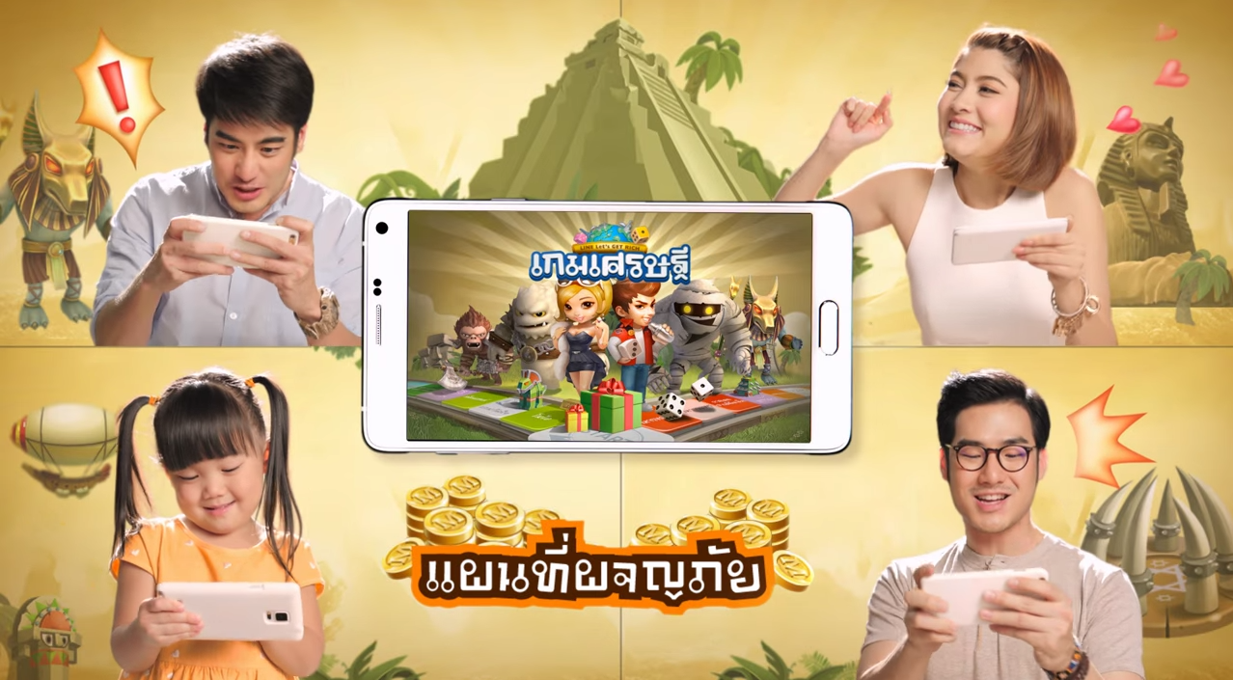
LINE - Case Study of Successful Games 1. LINE Let’s Get Rich เกมเศรษฐี Marketing Initiative – Viral Clips
6-minute, 5 M views clip (10 months ago) by Bie the Ska, a famous game caster Link: https://www.youtube.com/watch?v=bxzzOklVF_s - narrative based on game - humor - four actors/actresses (total number of players playable) - different demographics (materialistic women, gangster, employee at 7-eleven) - realistic settings: a Buddhist temple, below the motorway, and spirit house
5-minute, 2 M views clip (one year ago) by LINE Thailand Link: https://www.youtube.com/watch?v=tRsII-xece0 - a romantic-humor storyline that features ‘Opal’ Panisara Phimpru, a famous comedian - comically demonstrates the features (desert island) of the game
1-minute, 1 M views TVC released 1 month ago by LINE Thailand . Link: https://www.youtube.com/watch?v=JMY002SBamY - Boy Prakorn and Markie (top celebrities) - attract gamers, who have stopped playing the game, about the new updates - create in-game items related to TVC

Slide 11
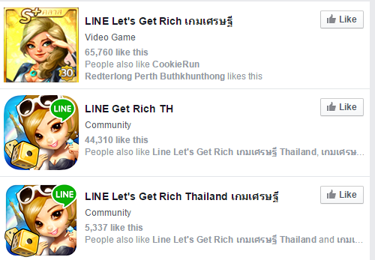
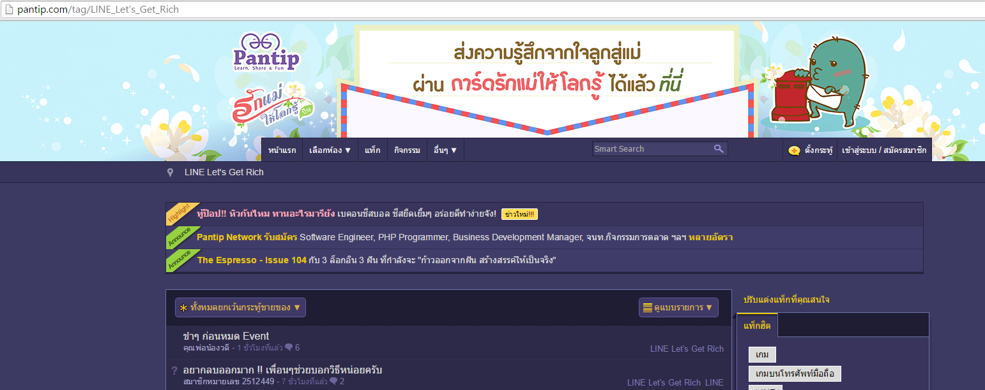
LINE - Case Study of Successful Games 1. LINE Let’s Get Rich เกมเศรษฐี
Marketing Initiative – Community
Organic FB communities with over 100 K Likes (cumulative)
Organic addictive community in pantip with an average of 8 posts a day (http://pantip.com/tag/LINE_Let's_Get_Rich)

Slide 12
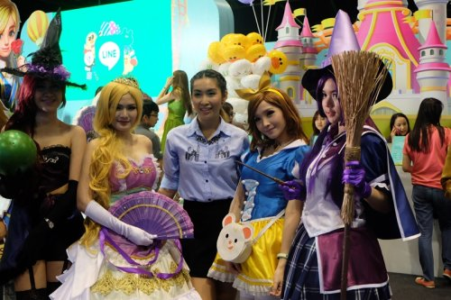
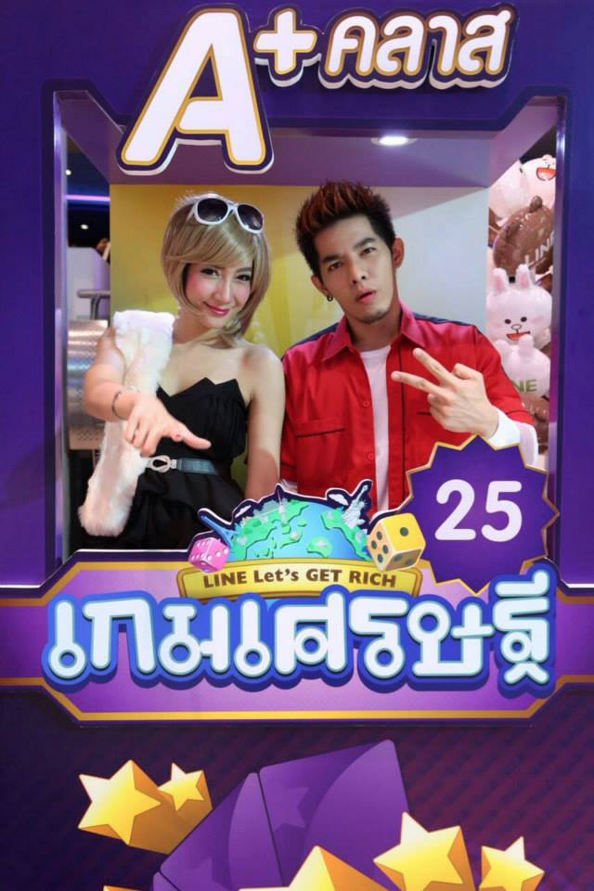
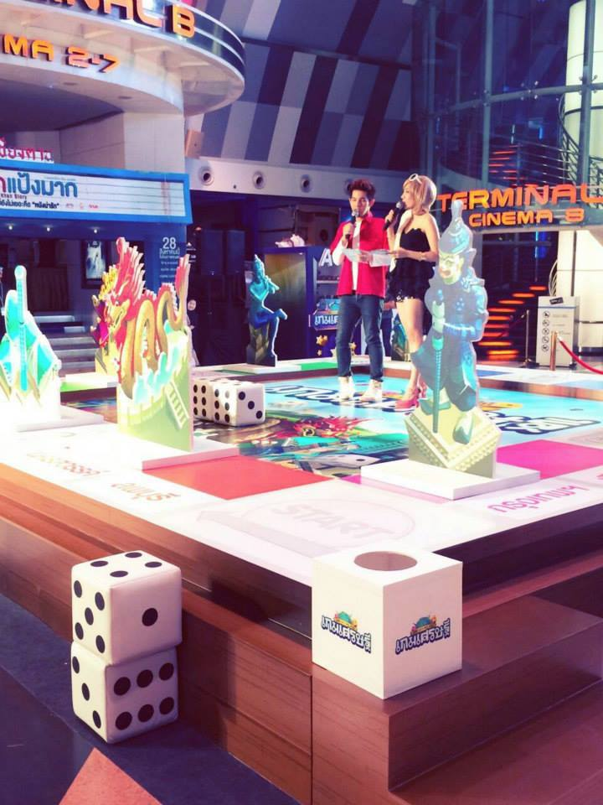
LINE - Case Study of Successful Games 1. LINE Let’s Get Rich เกมเศรษฐี
Marketing Initiative – Events 1/2
Event at Thailand Mobile Expo 2015 - Female cosplays, game casters, actors & prize worth up to 500,000 baht.
LINE Let’s Get Rich Thai Giant Board (31 Aug, 2014 – 12 Sept, 2014) - Hosted at SF Cinema at Central Ladprao. - Estimation of participants: 2,000 participant per day. - Set up 6x6m board game on the floor to allow participants to play the game live.

Slide 13



LINE - Case Study of Successful Games 1. LINE Let’s Get Rich เกมเศรษฐี
Marketing Initiative – Events 2/2
Example of an offline event When: | Event at Siam Center June 6, 2015
Description: | For fans to meet with brand ambassadors (from TVC) Abbreviated translated tagline: “Don’t miss your chances to get free gifts” “Get ready to meet with Boy Prakorn and Markie”
Takeaways: | - Engage target group, and increase game awareness
Reference: | https://www.facebook.com/LineLetGetRichThailand?fref=ts

Slide 14
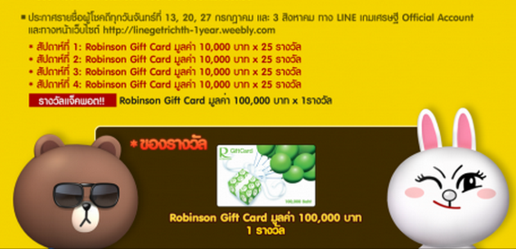
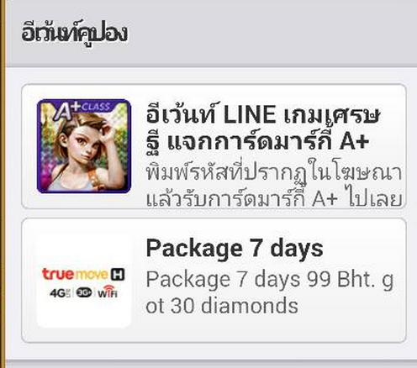

LINE - Case Study of Successful Games 1. LINE Let’s Get Rich เกมเศรษฐี
Marketing Initiative – Partnership
Robinson - gift card worth up to 10,000 baht x25 for 4 weeks
True – Free rare in-game items when refill
Tesco Lotus – Free LINE dolls, T-shirts, etc.
Notes:
https://www.facebook.com/LINELetGetRichThailand?fref=ts

Slide 15

LINE - Case Study of Successful Games 1. LINE Let’s Get Rich เกมเศรษฐี
Marketing Initiative – In-game Event
Name & When: | LINE Let’s Get Rich: Trip to Japan March 16, 2015 – April 15, 2015
Description: | Prize: trip to Japan (four seats) worth up to 200,000 baht Just play the game during the interval of the event
Takeaways: | - Increase DAU
Reference: | https://www.facebook.com/LINELetGetRichThailand/photos/a.1497726187129721.1073741829.1497293460506327/1603334493235556/?type=1&theater

Slide 16
LINE - Case Study of Successful Games 1. LINE Let’s Get Rich เกมเศรษฐี
Timeline in 2014
July 3, 2014
Download from Apple Store
July 27, 2014
Offline - Event hosted with KBANK and True at Central World – Opal and Sunny (ambassadors)
Oct. 2014
Offline - Event at Thailand Game Show Big Festival at Paragon
Oct. 2014
July 22, 2014
Online - Free “Opal” sticker released in LINE
Sept. 2014
Offline - Tesco Lotus Partnership (free LINE items)
Online - True Refill Promotion – Free in-game rewards
Notes:
From photos on FB: https://www.facebook.com/LINELetGetRichThailand?fref=ts

Slide 17
LINE - Case Study of Successful Games 1. LINE Let’s Get Rich เกมเศรษฐี
Timeline in 2015
Offline - Tournament at Thailand Mobile Expo 2015
Offline - Get Rich Thailand Champion League 2015
April 2015
Feb. 2015
June 6, 2015
July 9, 2015
Offline - Partnership with Robinson – gift cards (previous)
Offline - Event at Siam Center
Notes:
From photos on FB: https://www.facebook.com/LINELetGetRichThailand?fref=ts

Slide 18
LINE - Case Study of Successful Games 1. LINE Let’s Get Rich เกมเศรษฐี
Marketing Strategies
Upgraded brand ambassadors (Boy Prakorn and Markie over Sunny and Opal)
Strong online community on Facebook and pantip
Appearance in almost all major events (to retain existing users)

Slide 19

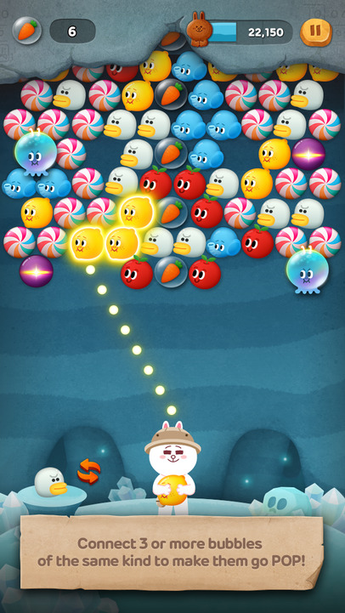
LINE - Case Study of Successful Games 2. LINE Bubble 2
Overview
Free Ranking | Thailand: 2 (iOS), - (Android)
Gross Ranking | Thailand: 89 (iOS), 94 (Android)
First Version Released | April 23, 2015
Brief description of game | (best explained through picture)
Target audience | Age: 18 – 35 Gender Ratio: 50 % Male, 50 % Female
Unique Selling Position | Cute LINE characters Only famous platform offering this game
Market Initiatives | Minimal because of its recentness Have 1.4 million users on April 24, 2015 (1 day after release)

Slide 20

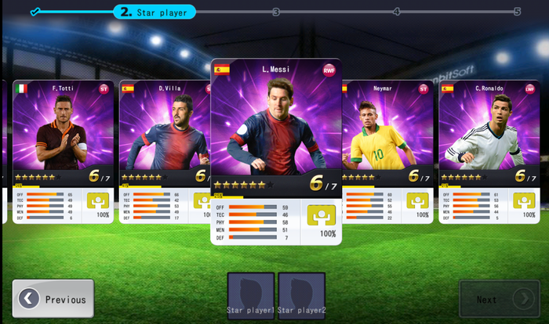

LINE - Case Study of Successful Games 3. LINE Football League Manager
Overview
Free Ranking | Thailand: - (iOS), - (Android)
Gross Ranking | Thailand: 9 (iOS), 40 (Android)
First Version Released | Jun 09, 2014
Brief description of game | “Become the manager of your own pro football team!”
Target audience | Age: 21 – 35 Gender Ratio: 100 % Male
Market Initiatives | Facebook community with 2k followers. Trip to watch Manchester United Vs. Liverpool (worth up to 250,000 baht) Get free line sticker upon download.
Notes:
http://www.ninefar.com/promotion/ดาวน์โหลด-line-football-league-manager-ลุ้นไปชมศึกแดงเดือดติดขอบสนาม-anfield/

Slide 21

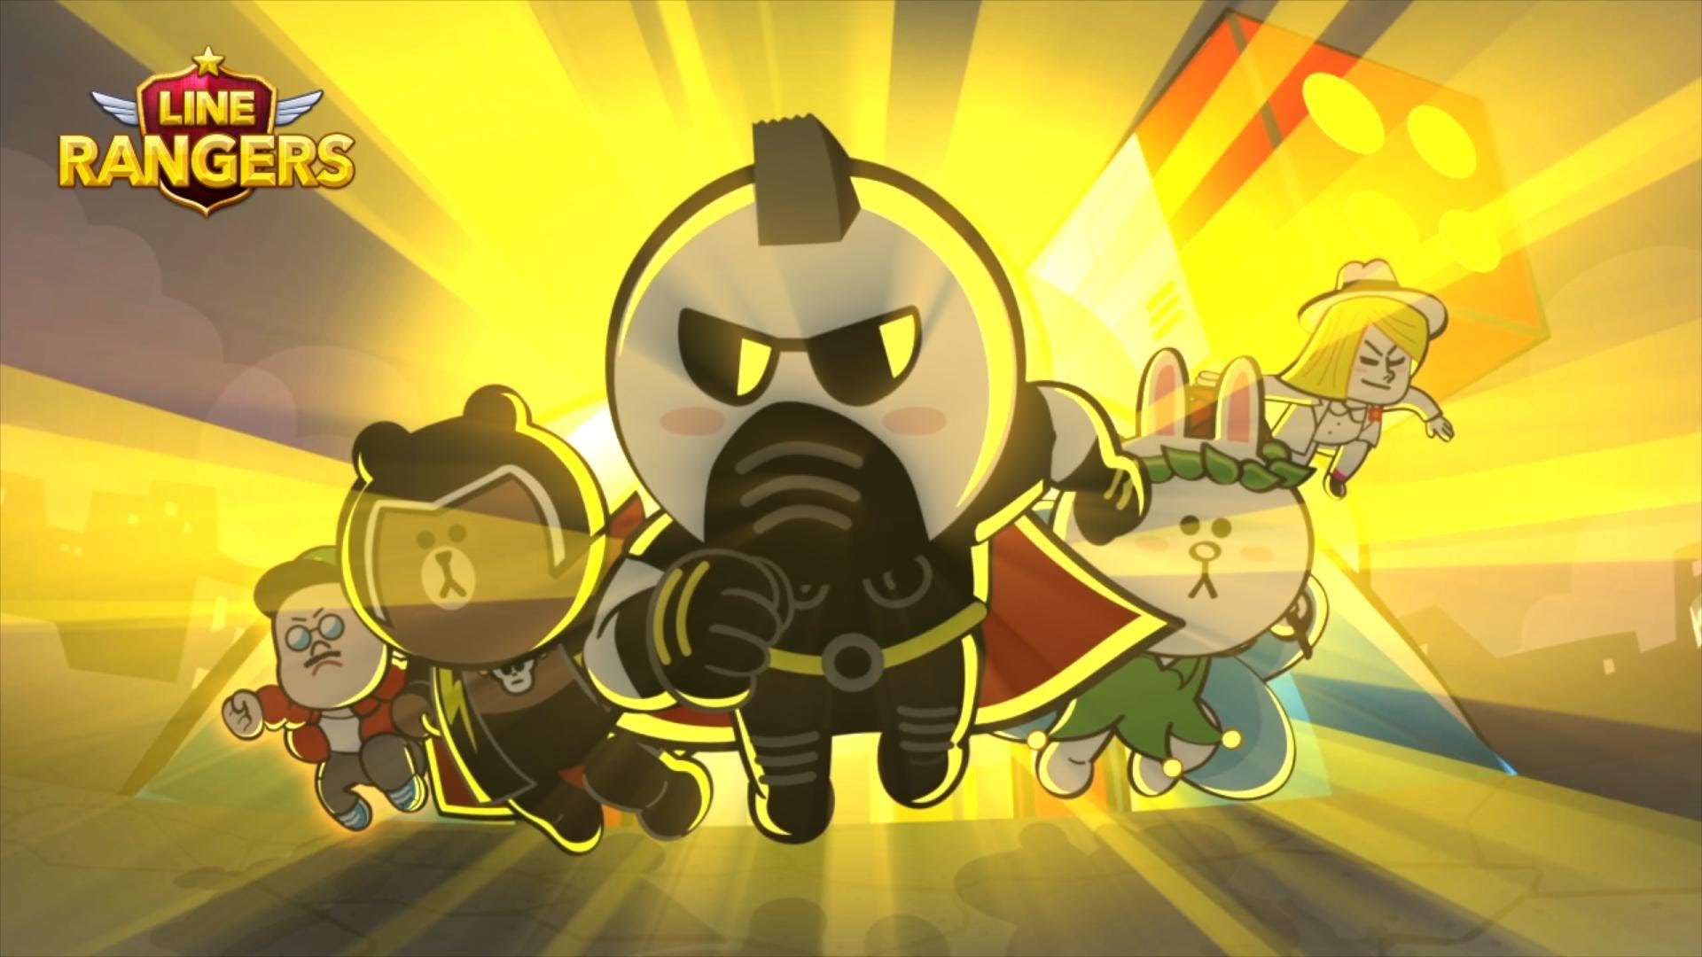

LINE - Case Study of Successful Games 4. LINE Rangers
Introduction
Free Ranking | Thailand: 59 (iOS), 64 (Android)
Gross Ranking | Thailand: 15 (iOS), 3 (Android)
First Version Released | Feb 27, 2014
Brief description of game | A defense battle game with adorable LINE characters.
Target audience | Age: 18 – 35 Gender Ratio: 50 % Male, 50 % Female
Unique Selling Position | Existing cute LINE Stickers in new looks New LINE Stickers

Slide 22
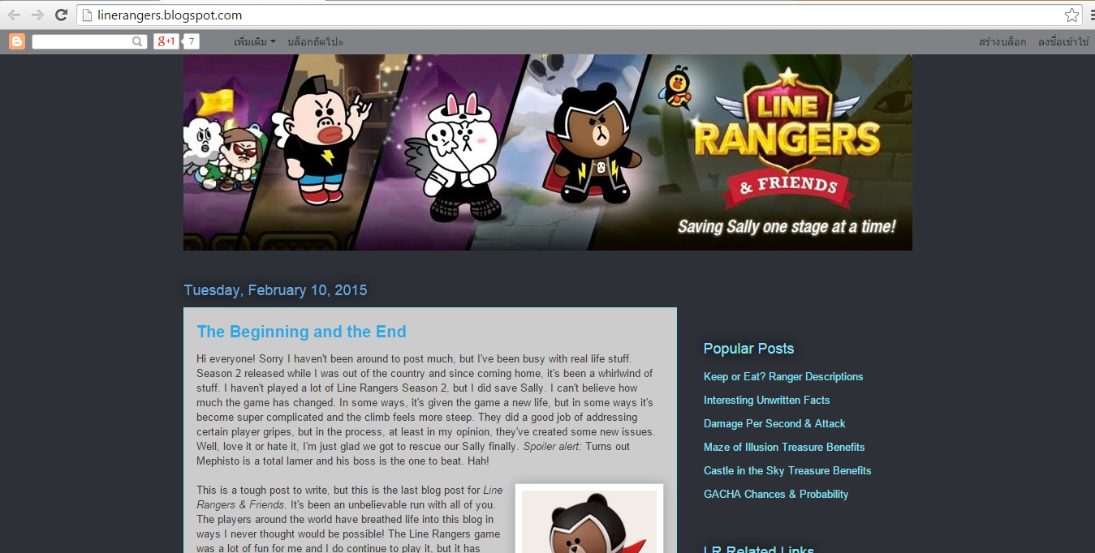
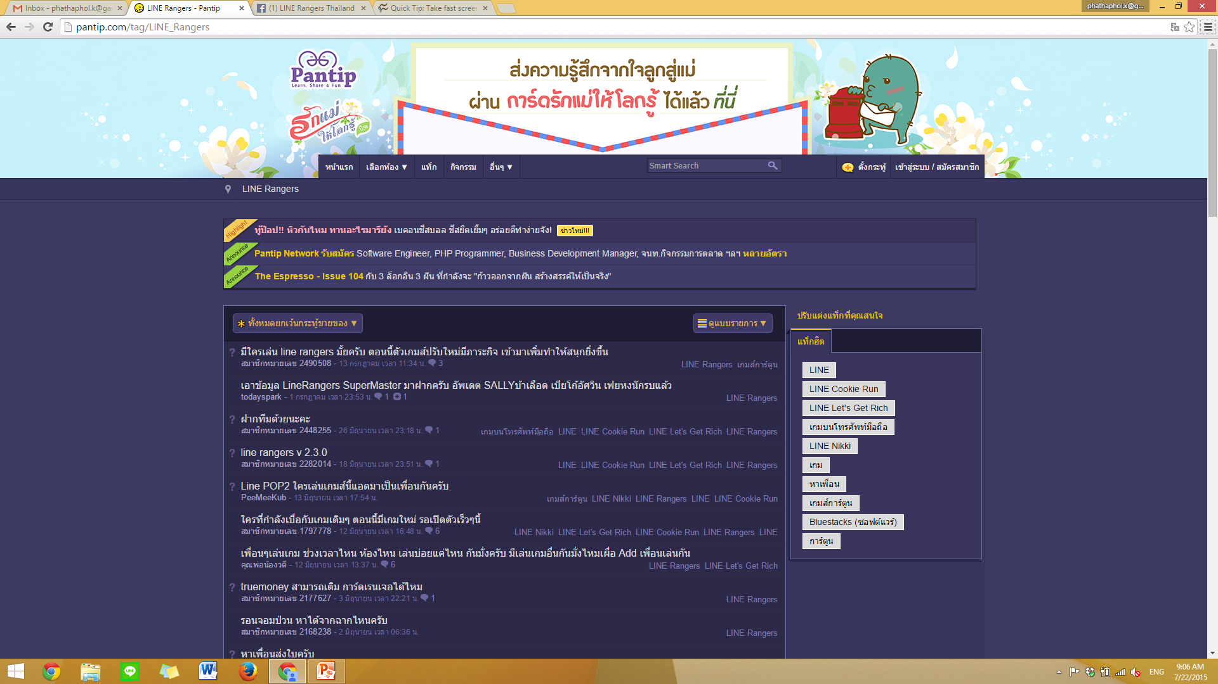
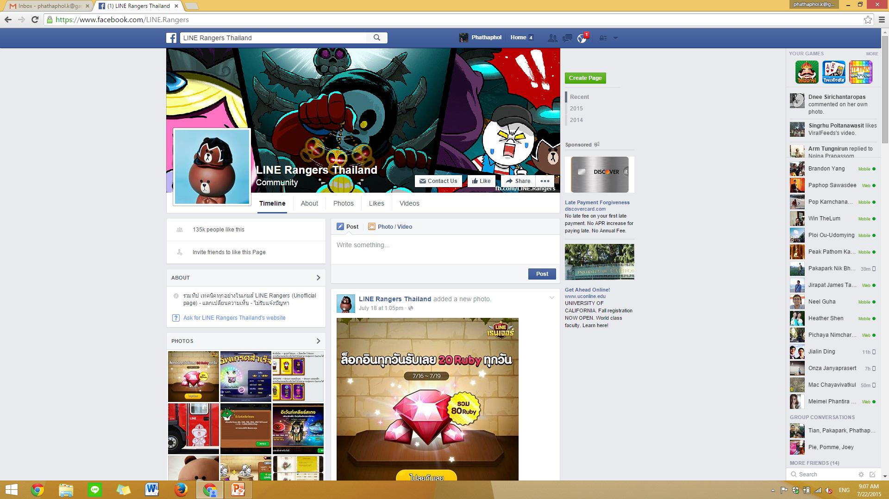
LINE - Case Study of Successful Games 4. LINE Rangers
Market Initiatives - Community
Own website. (English) (http://linerangersth.blogspot.com/)
Community in pantip (http://pantip.com/tag/LINE_Rangers) – a post every week
Create Facebook community (https://www.facebook.com/LINE.Rangers) - 135K Likes

Slide 23

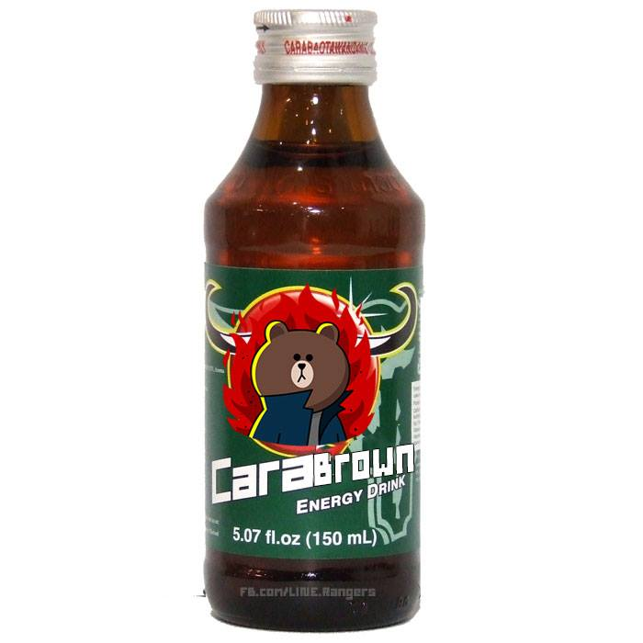
LINE - Case Study of Successful Games 4. LINE Rangers
Market Initiatives – Partnership 1/2
With AIS – Free limited edition dolls With Red Bull

Slide 24
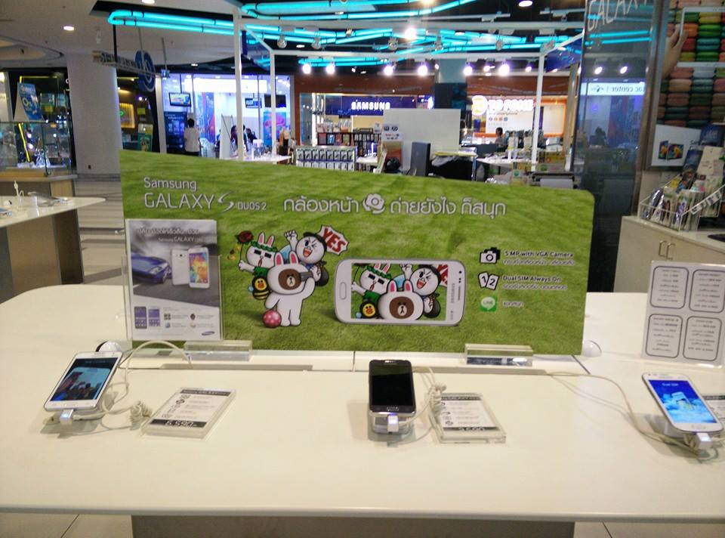
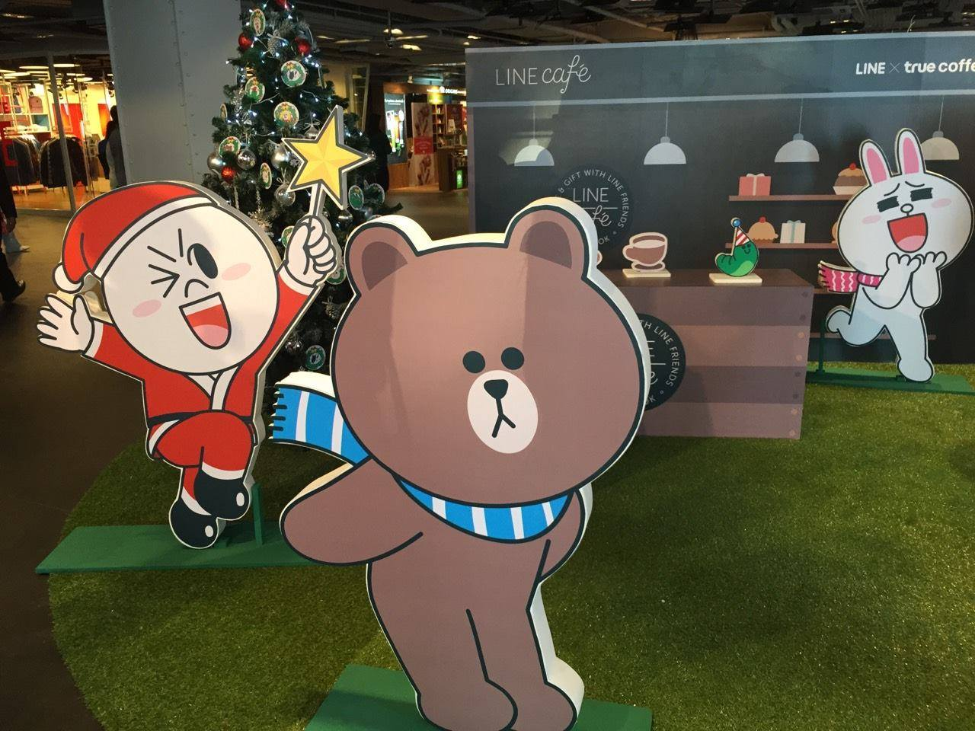
LINE - Case Study of Successful Games 4. LINE Rangers
Market Initiatives – Partnership 2/2
With Samsung With True – LINE x True Café

Slide 25
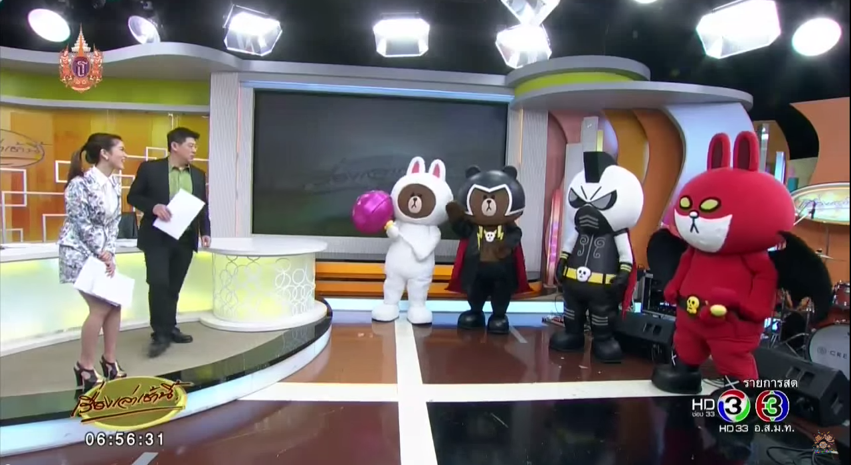
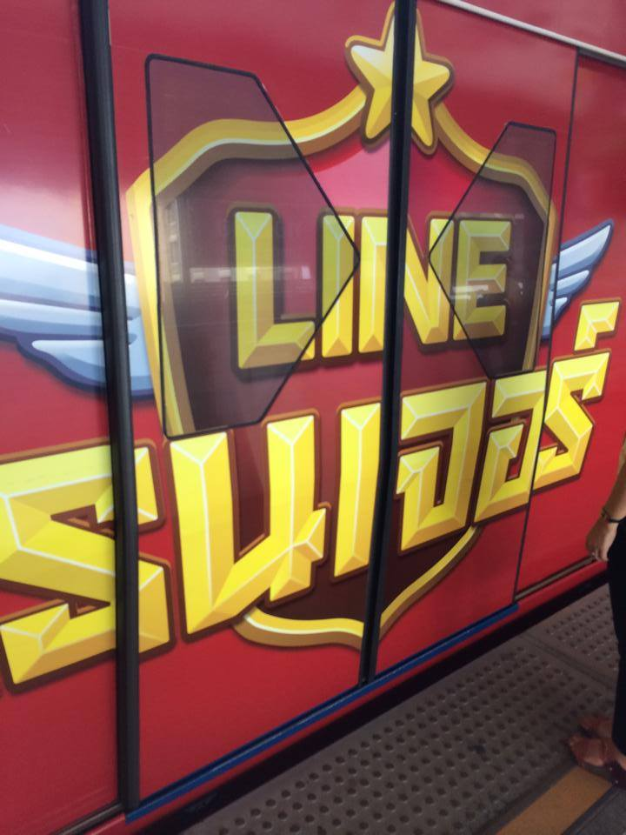
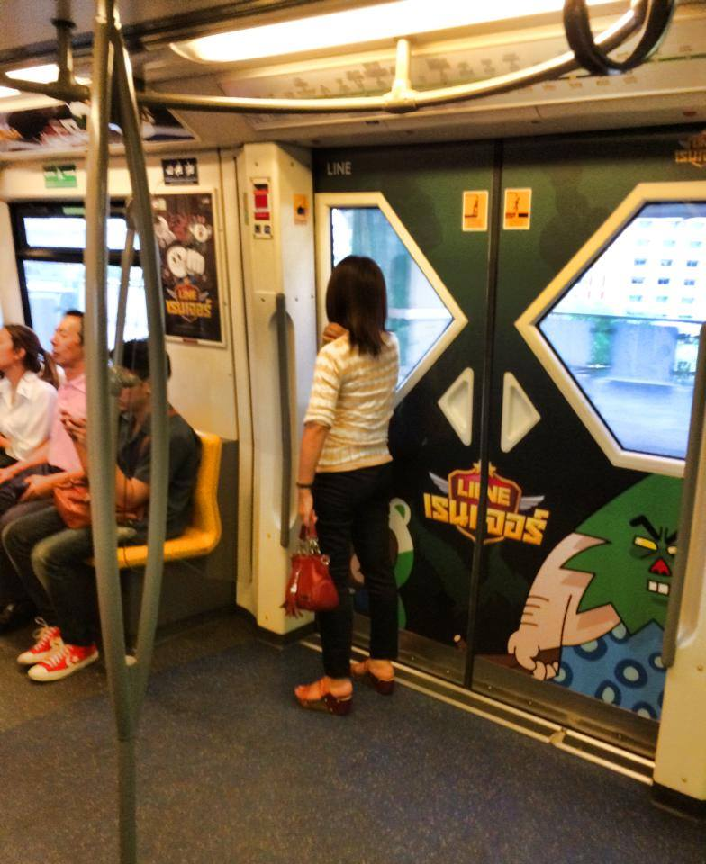
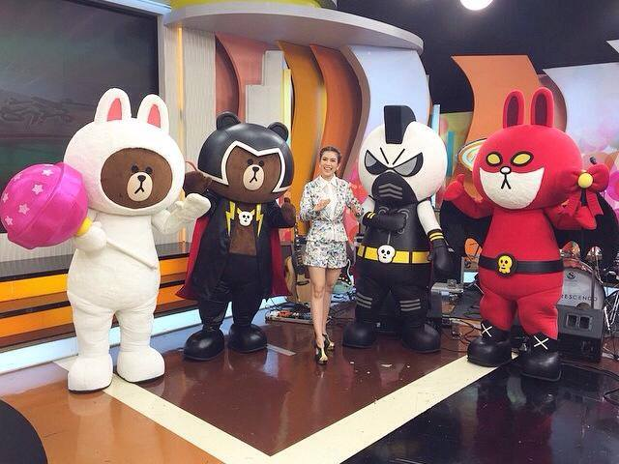
LINE - Case Study of Successful Games 4. LINE Rangers
Market Initiatives – Offline Media Push
External Media Push in TV Channel 3 Morning News and BTS Wrap (FB) Link: https://www.youtube.com/watch?v=P5Mpm9EFWw4

Slide 26

LINE - Case Study of Successful Games 4. LINE Rangers
Market Initiatives – Event
LINE Ranger Drawing Competition Link: https://www.youtube.com/watch?v=P5Mpm9EFWw4

Slide 27

LINE - Case Study of Successful Games
4. LINE Rangers
Market Initiatives – Noteworthy Japanese Campaign 1/4

Slide 28
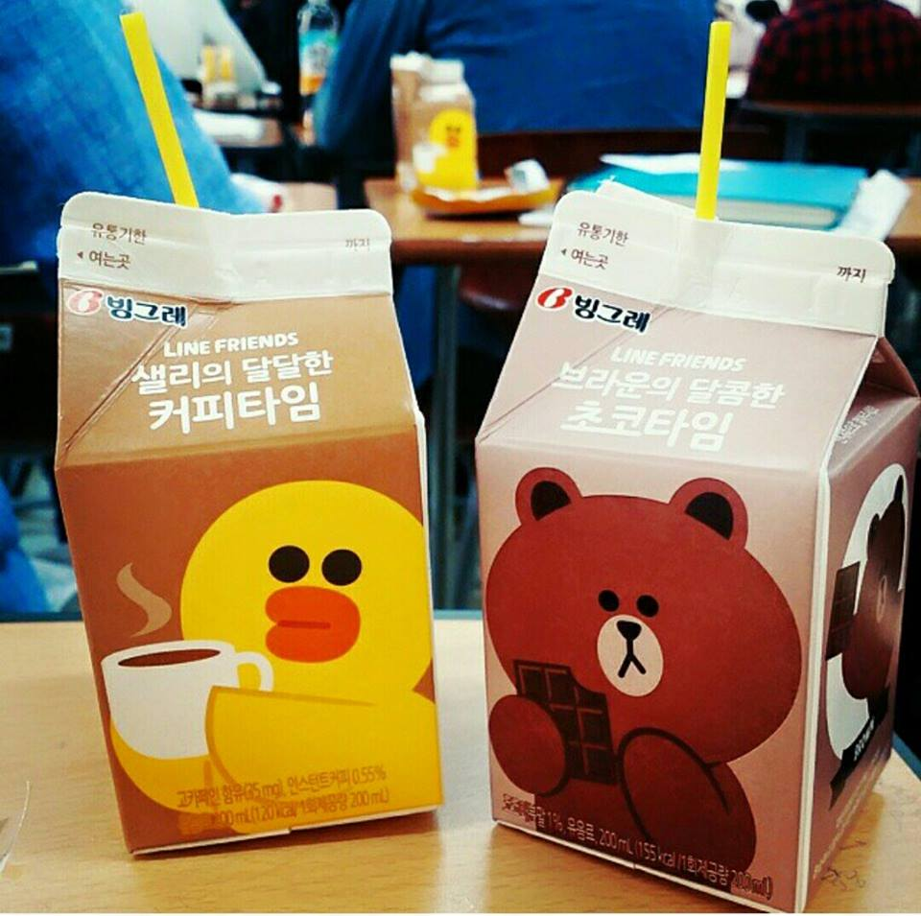
LINE - Case Study of Successful Games
4. LINE Rangers
Market Initiatives – Noteworthy Korean Campaign 2/4

Slide 29
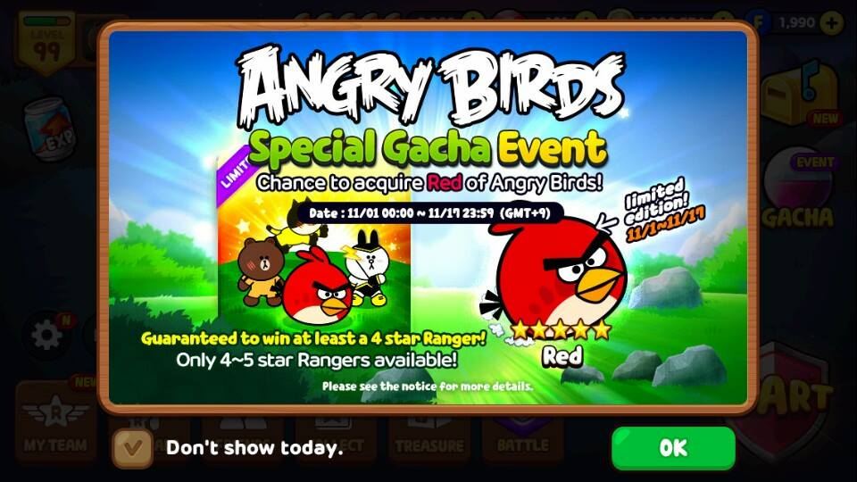
LINE - Case Study of Successful Games
4. LINE Rangers
Market Initiatives – Noteworthy International Campaign 3/4

Slide 30
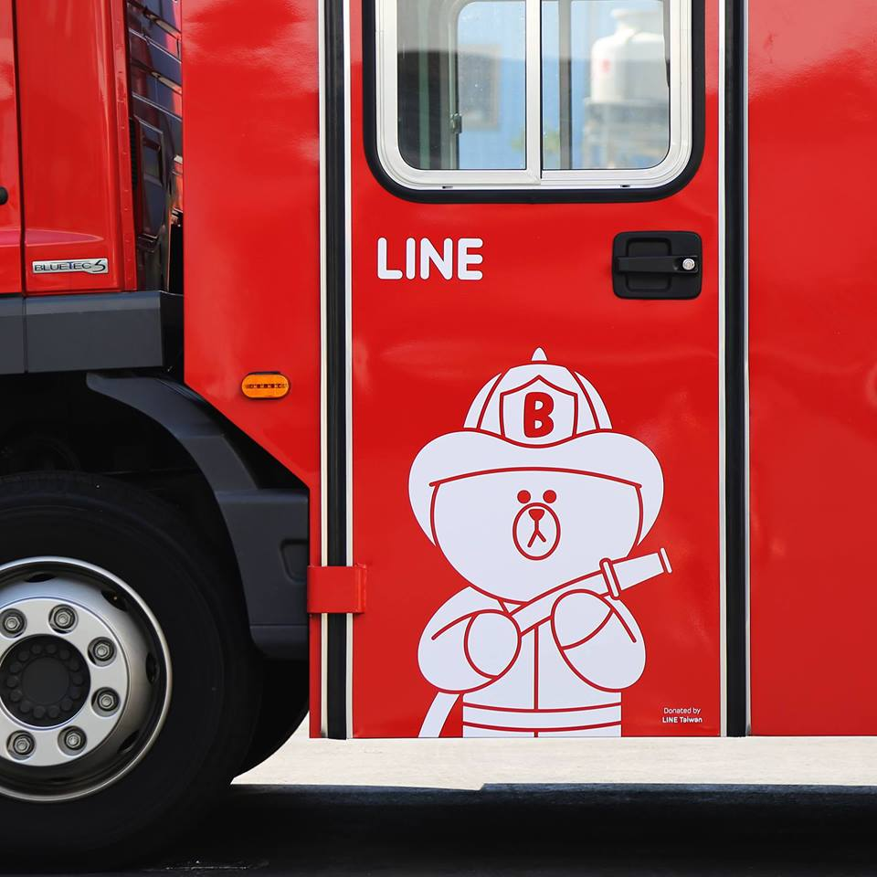
LINE - Case Study of Successful Games
4. LINE Rangers
Market Initiatives – Noteworthy International Campaign 4/4

Slide 31
LINE - Case Study of Successful Games 4. LINE Rangers
Market Initiatives – Timeline 1/4
Feb 27, 2014
Download from Apple Store
March 22, 2014
Online – Pic posted in FB about the 1000 Likes of the
March 18, 2014
Online - Free “LINE ” sticker released in LINE
May 8-11, 2014
Offline – Mobile Expo Event
April 30, 2014
Offline – Thailand Toy Expo
Notes:
From photos on FB: https://www.facebook.com/LINELetGetRichThailand?fref=ts
Dates are from the day the pic is posted

Slide 32
LINE - Case Study of Successful Games 4. LINE Rangers
Market Initiatives – Timeline 2/4
Offline – BTS Wrap
Online – LINE Post by Songkran, Winner of the Voice 2 about the game
May 25, 2014
May – June 2014
June 6, 2014
June 10, 2014
Offline – Partnership with Red Bull
Online – New Free LINE Rangers Stickers
Notes:
From photos on FB: https://www.facebook.com/LINELetGetRichThailand?fref=ts

Slide 33
LINE - Case Study of Successful Games 4. LINE Rangers
Market Initiatives – Timeline 3/4
Online – Find Lucky code in Ranger’s Video (gifts)
Offline – Partnership with Samsung
August 21, 2014
July 25, 2014
Oct. 31, 2014
Online – Partnership with 7-11 – Free LINE Bag
Online – Partnership with Rovio for Angry Bird’s in-game character
Nov. 27, 2014
Notes:
From photos on FB: https://www.facebook.com/LINELetGetRichThailand?fref=ts

Slide 34
LINE - Case Study of Successful Games 4. LINE Rangers
Market Initiatives – Timeline 4/4
Offline – LINE x True Coffee at Siam Center
March 16, 2015
Dec. 26, 2014
April 10, 2015
Offline – Thailand Mobile EXPO
May 6, 2015
Offline – TV Ch. 3 Morning News to promote LINE Game Festival
Offline – Partnership with AIS
Notes:
From photos on FB: https://www.facebook.com/LINELetGetRichThailand?fref=ts

Slide 35
LINE - Case Study of Successful Games 4. LINE Rangers
Market Strategies
Single, organic online community on Facebook
Appearance in all major events
Significantly use LINE products to promote the game
Hosting their own offline events

Slide 36

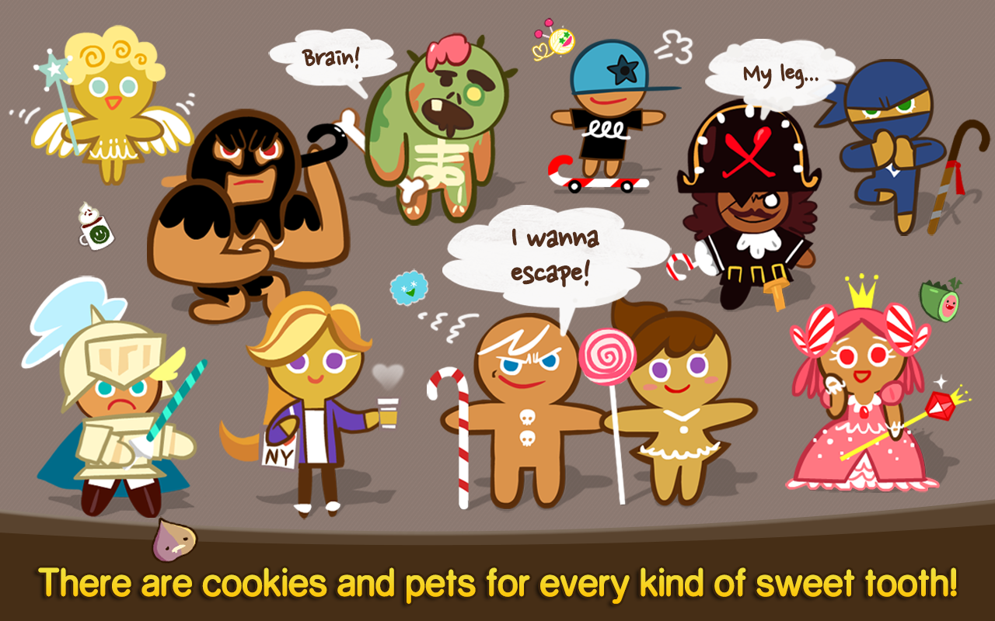
LINE - Case Study of Successful Games 5. LINE Cookie Run
Introduction
Free Ranking | Thailand: 19 (iOS), 16 (Android)
Gross Ranking | Thailand: 18 (iOS), 13 (Android)
First Version Released | Jan 28, 2014
Brief description of game | “Be a Cookie Hero … Control your character either with touch screen gestures or virtual buttons.”
Target audience | Age: 18 – 35 Gender Ratio: 50 % Male, 50 % Female

Slide 37
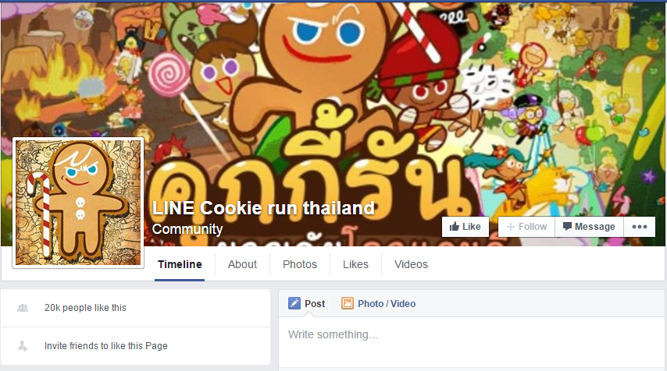
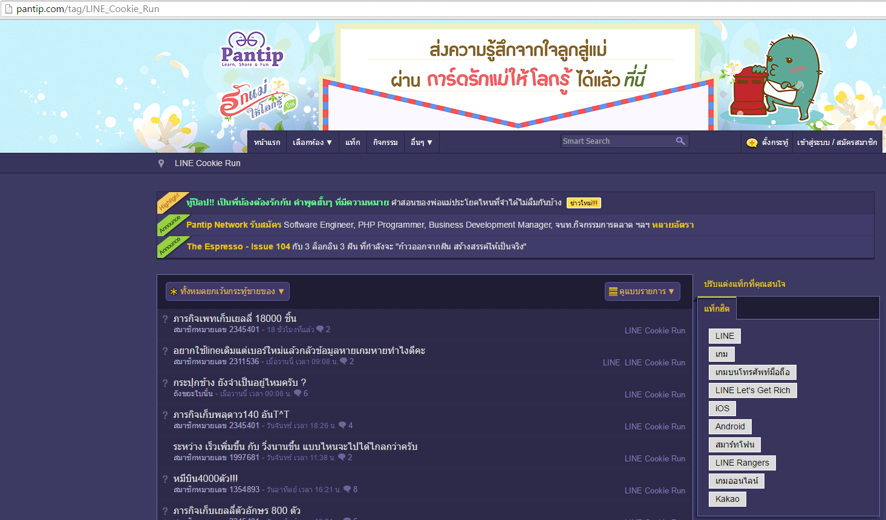
LINE - Case Study of Successful Games 5. LINE Cookie Run
Marketing Initiatives - Community
Not too organic Facebook Community with 20K Likes
Organic Pantip community with an average of a post per day

Slide 38


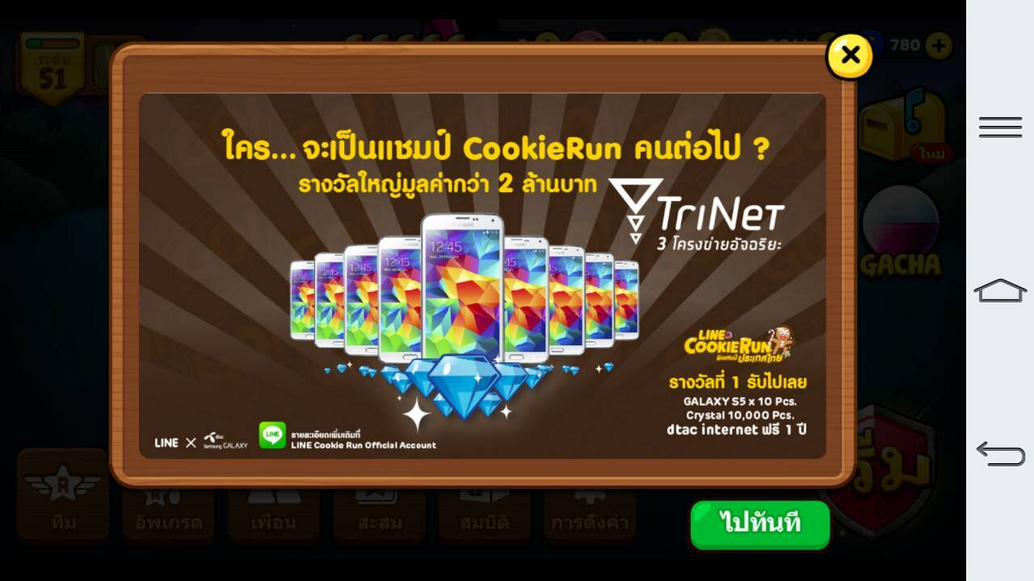
LINE - Case Study of Successful Games 5. LINE Cookie Run
Marketing Initiatives - Partnership
With Toyota – Free Toyota Yaris by downloading the game With AIS 3G – Extra rewards for Top-ups including thumb drive With Samsung – Free phones for winners of tournament

Slide 39
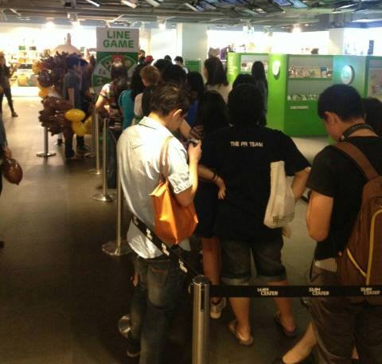
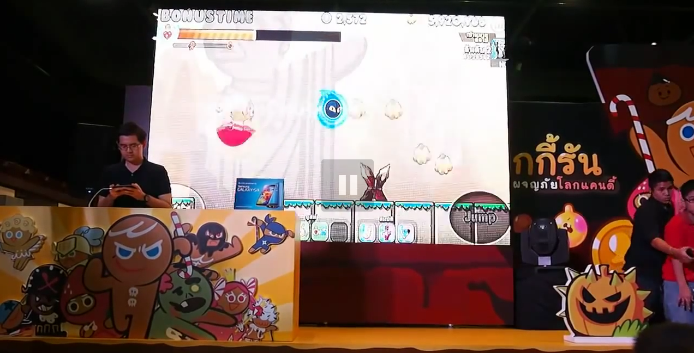
LINE - Case Study of Successful Games 5. LINE Cookie Run
Marketing Initiatives - Events
LINE Game Event
Cookie Run Thailand Championship Link: https://www.youtube.com/watch?v=Rw0pJKkVyOY

Slide 40
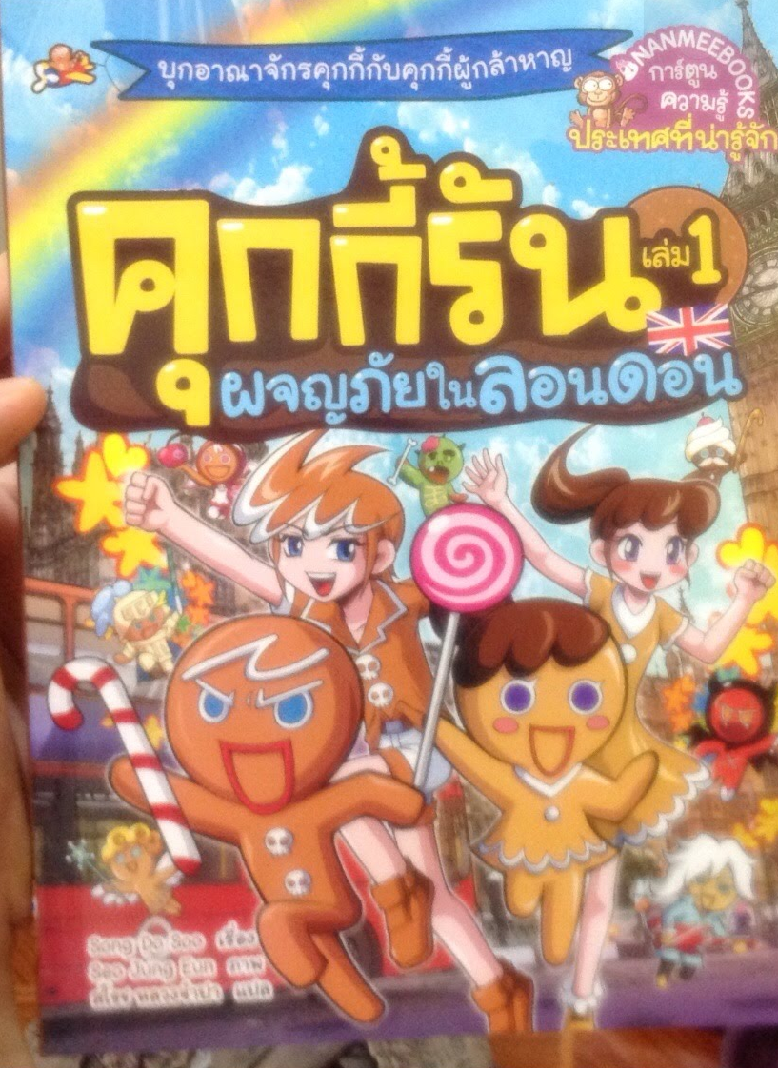
LINE - Case Study of Successful Games 5. LINE Cookie Run
Interesting Marketing Initiative
Comic Book: Cookie Run Go To London

Slide 41
LINE c. Case Study of Unsuccessful Games
1. LINE Jelly
2. LINE Dragon Flight

Slide 42


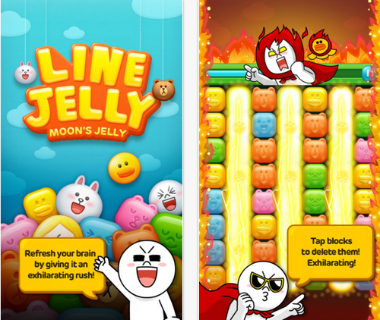
LINE - Case Study of Unsuccessful Games 1. LINE Jelly
Overview
Duration | April 18, 2013 – November 28, 2014
Brief description of game | Similar to LINE POP, BUBBLE. Puzzle game to score as high as possible by deleting as many blocks as you can
# of Likes in Thailand FB | 360 likes
Target audience | Age: 18 – 35 Gender Ratio: 50 % Male, 50 % Female
Market Initiatives | Minimal Free LINE stickers after completing a certain mission within the game
Notes:
https://www.facebook.com/pages/LINE-JELLY/654894321216234?ref=br_rs
https://www.facebook.com/LINEJellyThailand/timeline
http://line-jelly.soft112.com/
http://www.cheatsapps.com/app/LINE-JELLY-walkthrough
http://imobizone.com/complete-missions-in-line-jelly-to-get-original-stickers-featuring-moon-and-the-boss/

Slide 43

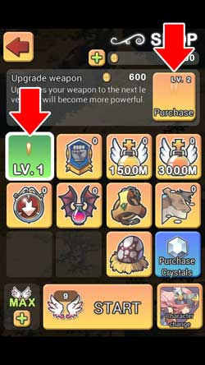
LINE - Case Study of Unsuccessful Games 2. LINE Dragon Flight
Overview
Duration | April 1, 2013 (first post on FB) – November 28, 2014
Brief description of game | Simple shooting game that is similar to Garena’s Thunderstrike
# of Likes in Thailand FB | About 2400 likes
Target audience | Age: 15 – 35 Gender Ratio: 80 % Male, 20 % Female
Market Initiatives | Minimal Consistent FB posts of score rankings (to motivate current players to beat the score)

Slide 44
LINE d. Conclusion
Garena’s most important gaming competitor: LINE
Games: casual & easy to play
Include Line’s stickers in almost every LINE games → targeting female
Marketing Strategy:
80 % offline media pushes (attending events and even creating their own LINE events), 20 % online media pushes (stickers, refill)
Offline events are focused during the first few months (LINE Ranger)
Offline events are more spread out (LINE Let’s Get Rich)

Slide 45

B. AsiaSoft

Slide 46
Major Gaming Companies B. AsiaSoft Corporation
a. Brief Introduction
b. Case Study of Success Stories
c. Case Study of Non-successful Stories
d. Marketing Strategies

Slide 47

AsiaSoft Cooperation a. Brief Introduction
Subsidiary Company | PlayPark (name in Android)
Initial Release | 2001
Operating System | Android and iOS (mobile games)
Type | Online Massive Multiplayer Game Providers
Headquarter | Bangkok, Thailand

Slide 48
AsiaSoft Cooperation b. Case Study of Successful Games
1. Ragnarok Mobile สงครามฮีโร่
2. Heart Castle

Slide 49

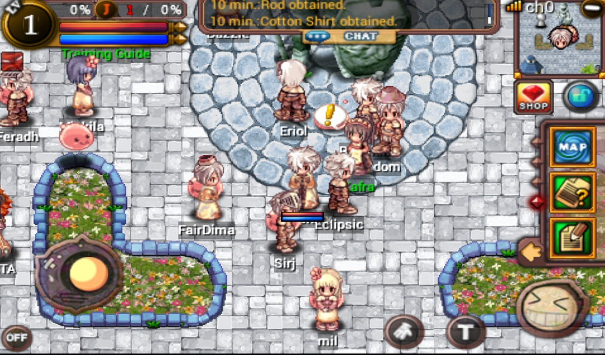
AsiaSoft - Case Study of Successful Games 1. Ragnarok Mobile สงครามฮีโร่ Introduction
Free Ranking | Thailand: - (iOS), - (Android)
Gross Ranking | Thailand: 5 (iOS), 52 (Android)
First Version Released | Dec. 14, 2013
Brief description of game | Ex-most popular and addictive MMORPG (Massively multiplayer online role-playing games) in your mobile phone
Target audience | Age: 18 – 35 Gender Ratio: 100 % Male, 0 % Female

Slide 50
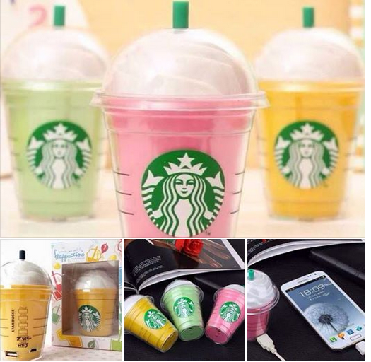
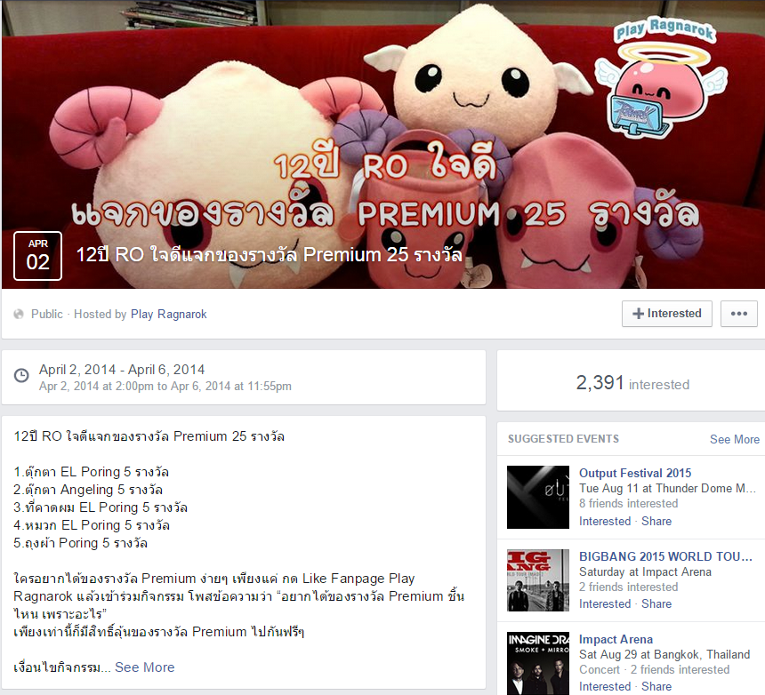
AsiaSoft - Case Study of Successful Games 1. Ragnarok Mobile สงครามฮีโร่ Marketing Initiatives - Partnership
Selling power bank with Starbucks design (see next slide for screenshot) FB doll giveaways event: Like + Explain why you want these dolls

Slide 51
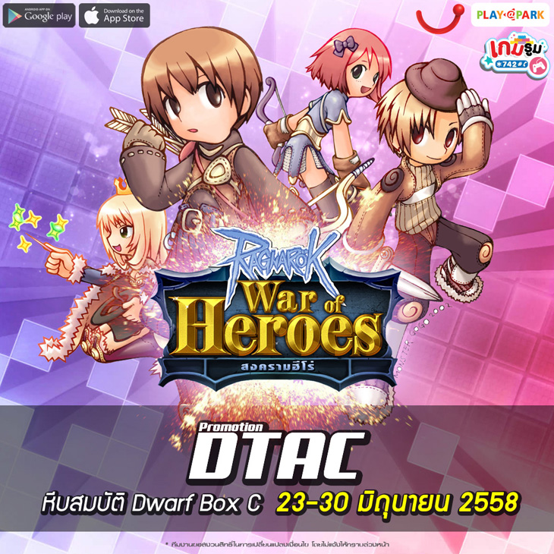
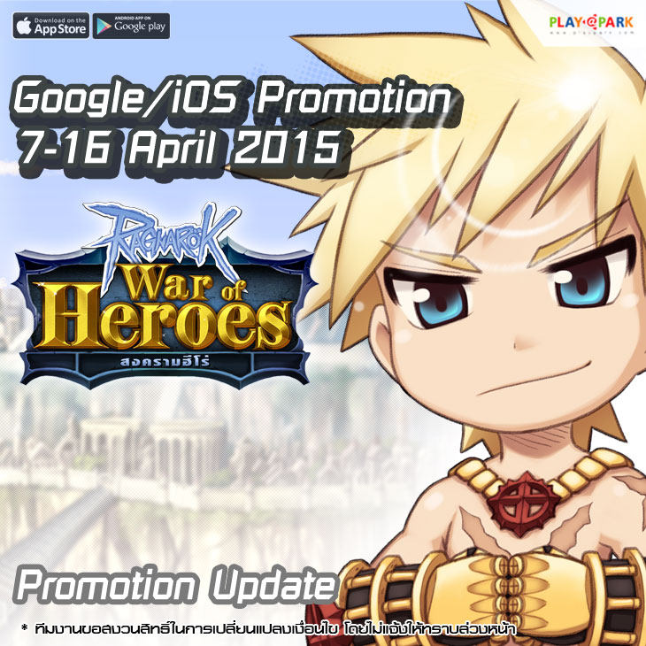

AsiaSoft - Case Study of Successful Games 1. Ragnarok Mobile สงครามฮีโร่ Marketing Initiatives - Refill
Free item when refill via Dtac Extra ruby when refill via Google/App Store
Notes:
http://news.playpark.com/th/28468

Slide 52

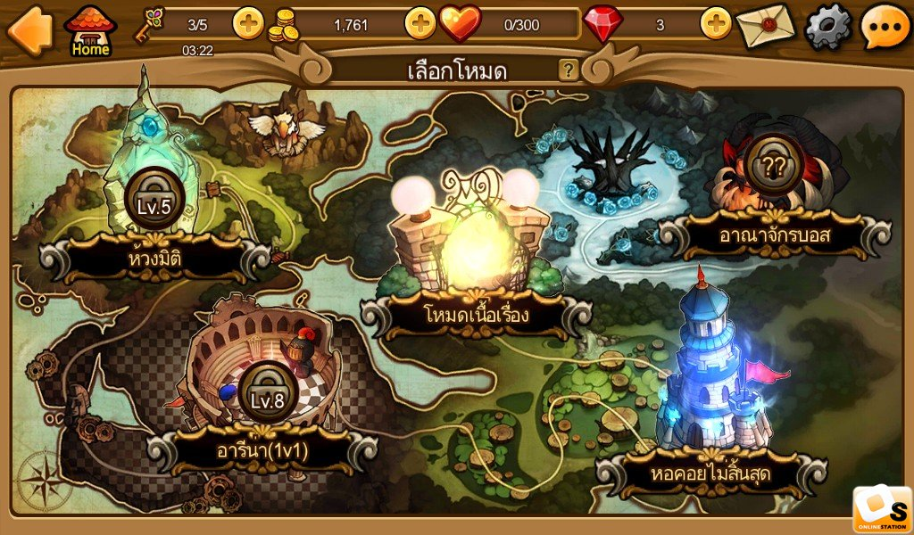
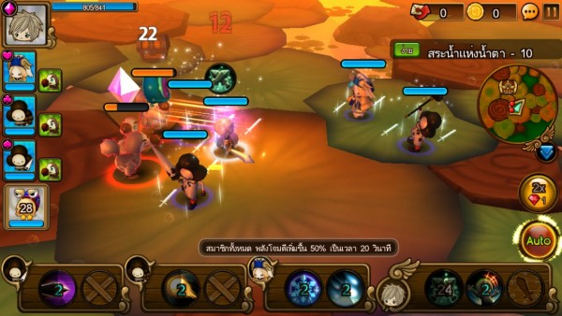
AsiaSoft - Case Study of Successful Games 2. Heart Castle Introduction
Free Ranking | Thailand: 19 (iOS), 16 (Android)
Gross Ranking | Thailand: 18 (iOS), 13 (Android)
First Version Released | April 01, 2015
Brief description of game | “Run, jump, and slide your way to freedom! Control your character either with touch screen gestures or virtual buttons.”
Target audience | Age: 18 – 35 Gender Ratio: 100 % Male, 0 % Female

Slide 53

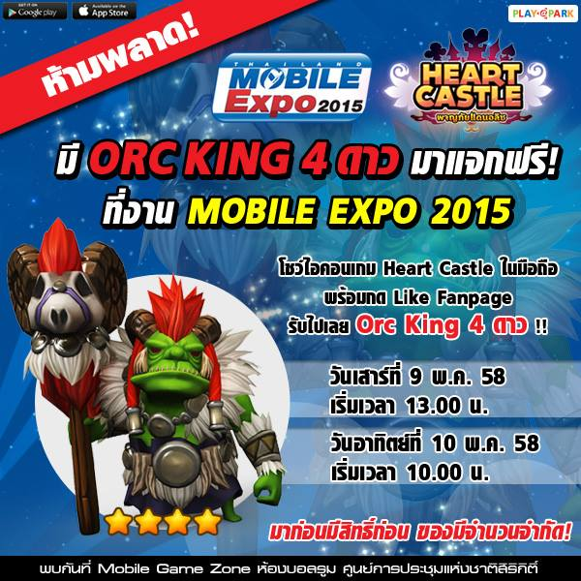
AsiaSoft - Case Study of Successful Games 2. Heart Castle Marketing Initiatives – FB + Events
Free prize if user shares and likes a video via FB Free gift at Mobile Expo 2015
Notes:
http://news.playpark.com/th/29145
http://news.playpark.com/th/29146

Slide 54



AsiaSoft - Case Study of Successful Games 2. Heart Castle Marketing Initiatives - Refill
Partnership with JAXX MIX (Calbee) (producer of snacks) to earn in-game items and 89-baht refill worth up to 300,000 baht Partnership with AIS One-2-Call (carrier) to get free in-game items
Notes:
http://news.playpark.com/th/29145
http://news.playpark.com/th/29146

Slide 55

AsiaSoft - Case Study of Successful Games 2. Heart Castle Marketing Initiatives - Refill
Free item when refill via Playpark Wallet, AsiaSoft’s own refill method
Notes:
http://news.playpark.com/th/29854

Slide 56
AsiaSoft Cooperation c. Case Study of Unsuccessful Games
1. Advance Dino
2. FC Manager

Slide 57




AsiaSoft - Case Study of Unsuccessful Games 1. Advance Dino Overview
Free Ranking | Thailand: - (iOS), - (Android)
Gross Game Ranking | Thailand: 325 (iOS), 126 (Android)
First Version Released | Oct. 13, 2014
Brief description of game | 3D city building, strategic game to build your own base (dinosaur units) and survive against the Dino empire.
Target audience | Age: 21 – 35 Gender Ratio: 80 % Male, 20 % Female
Notes | Facebook page with 9k Likes Bugs within game Bugs with refill
Notes:
https://play.google.com/store/apps/details?id=com.playpark.advancingdino&hl=en
https://www.facebook.com/Playpark.AdvanceDinoTH?fref=ts

Slide 58

AsiaSoft - Case Study of Unsuccessful Games 1. Advance Dino Marketing Initiatives - Refill
Extra gems when refill during event Dino Gag – post on FB of a dinosaur-related jokes and earn in-game prizes
Notes:
http://news.playpark.com/th/29854

Slide 59


AsiaSoft - Case Study of Successful Games 2. FC Manager Overview
Free Ranking | Thailand: - (iOS), - (Android)
Gross Ranking | Thailand: - (iOS), - (Android)
First Version Released | Mar 28, 2015
Brief description of game | Football management game; Manage and own your own football club
Target audience | Age: 18 – 35 Gender Ratio: 100 % Male, 0 % Female
Notes | Own website: http://fcm.playpark.com/th/Index Facebook Page with 47k Likes: https://www.facebook.com/fcmth Playable in PC. One account for PC and mobile Why might fail? Already too many existing soccer mobile games e.g. LINE Football League Manager

Slide 60


AsiaSoft - Case Study of Successful Games 2. FC Manager Marketing Initiatives - FB
Facebook events to win in-game prizes: 1. Share clip 2. Like & Share
Notes:
http://news.playpark.com/th/29854

Slide 61
AsiaSoft Cooperation d. Marketing strategies
30% events, 70% refill partnership to offer bonus gems or extra items when refilling using certain method
Not too many offline marketing events – relies on refill promotions instead

Slide 62

C. SiamGame

Slide 63
C. SiamGame
a. Brief Introduction
b. Case Study of Success Stories
c. Case Study of Non-successful Stories
d. Conclusion

Slide 64
SiamGame a. Brief Introduction
Founded | Est. 2012
Operating System | iOS and Android
Headquarter | Thailand

Slide 65
SiamGame b. Case Study of Successful Games
1. Kung Fu House
2. LINE I am Wukong
3. Super Samkok

Slide 66




SiamGame - Case Study of Successful Games 1. Kung Fu House
Introduction
Free Ranking (July 16, 2015) | Thailand: 1255 (iOS), - (Android)
Gross Ranking (July 16, 2015) | Thailand: 14 (iOS), 6 (Android)
First Version Released | Oct 22, 2013
Brief description of game | Famous 3D Mobile Card Game with DIY maneuvering + original storyline
Target audience | Age: 18 – 35 Gender Ratio: 100 % Male, 0 % Female

Slide 67


SiamGame - Case Study of Successful Games 1. Kung Fu House
Marketing Initiatives
Create LINE stickers Partnership with MOL (money online) for prizes
Notes:
http://www.online-station.net/event/gameonline/6740

Slide 68



SiamGame - Case Study of Successful Games 2. LINE I am Wukong Introduction
Free Ranking (July 16, 2015) | Thailand: - (iOS), - (Android)
Gross Ranking (July 16, 2015) | Thailand: 218 (iOS), 140 (Android)
First Version Released | June 3, 2014
Brief description of game | First collaboration between Siam Games and Line Similar to Kung Fu House
Target audience | Age: 18 – 35 Gender Ratio: 100 % Male, 0 % Female

Slide 69


SiamGame - Case Study of Successful Games 2. LINE I am Wukong
Marketing Initiatives
FB event: Share pictures + Like to receive in-game prizes Predict-winner event during World Cup to receive free prizes
Notes:
https://www.facebook.com/wk.siamgame.in.th/events

Slide 70


SiamGame - Case Study of Successful Games 2. LINE I am Wukong
Marketing Initiatives
Event during Open Beta Test: Double the gems when refill for the first time Share page in FB to get a chance to win free items
Notes:
https://www.facebook.com/wk.siamgame.in.th/events
http://wk.siamgame.in.th/2014/activites_0604/362.html

Slide 71





SiamGame - Case Study of Successful Games 3. Super Samkok Introduction
Free Ranking (July 11, 2015) | Thailand: - (iOS), - (Android)
Gross Ranking (July 11, 2015) | Thailand: 52 (TH-Games) (iOS), 107 (Android)
First Version Released | Oct. 8, 2014
Brief description of game | Online Card game involving characters from the famous series “The Three Kingdoms”
Target audience | Age: 18 – 35 Gender Ratio: 100 % Male, 0 % Female

Slide 72

SiamGame - Case Study of Successful Games 3. Super Samkok
Marketing Initiative
FB events: Take a photo of advertisements found on BTS to receive in-game prizes and iPhones
Notes:
https://www.facebook.com/ss.siamgame.in.th/events

Slide 73



SiamGame - Case Study of Successful Games 3. Super Samkok
Marketing Initiative
Events during Open Beta Test: In-game awards for logging in everyday Free rare character First-time refill to get rare item
Notes:
https://www.facebook.com/ss.siamgame.in.th/events

Slide 74
SiamGame c. Case Study of Unsuccessful Games
1. Little General

Slide 75

SiamGame - Case Study of Unsuccessful Games 1. Little General Overview
Free Ranking (July 11, 2015) | Thailand: - (iOS), - (Android)
Gross Ranking (July 11, 2015) | Thailand: - (iOS), - (Android)
First Version Released | March 28, 2014
Brief description of game | Strategic game
Target audience | Age: 18 – 35 Gender Ratio: 100 % Male, 0 % Female
Notes | Minimal information on marketing initiatives because of deleted Facebook page and removal of game from Apple and Google Stores
Notes:
http://www.siamgame.in.th/gamelist/

Slide 76
SiamGame d. Conclusion
Marketing strategies: create very organic FB community – events about World Cup (Thai most anticipated sport event), partnership with MOL (refill platform)
Not too many offline marketing events – relies on in-game promotions instead
Biweekly in-game events

Slide 77
2) Top Grossing Games
As of July 15, 2015

Slide 78
2) Top Grossing Games
iOS
LINE Let’s Get Rich (see above)
Summoners War
Clash of Clan
Clash of Kings – Last Empire
Candy Crush Saga
Pirate Kings
Slots Vacation – Free Slot Machine
Kung Fu House - ศึกชิงเจ้าสำนัก
LINE Bubble 2 (see above)
มังกรหยก Frontier
Android
LINE Let’s Get Rich (see above)
Summoners War
Clash of Kings – Last Empire
Clash of Clan
LINE Rangers (see above)
Kung Fu House - ศึกชิงเจ้าสำนัก
มังกรหยก Frontier
Dot Arena
Marvel Future Fight
Candy Crush Saga

Slide 79


Top Grossing Games a. Summoners War
Introduction
Company | Com2uS
Free Ranking | Thailand: 93 (iOS), 93 (Android)
Gross Ranking | Thailand: 3 (iOS), 2 (Android)
First Version Released | July 4, 2012
Brief description of game | Action-packed fantasy RPG with over 800 different types of monsters to battle against Over 38 million users around the world
Target audience | Age: 18 – 35 Gender Ratio: 100 % Male, 0 % Female
Notes:
https://play.google.com/store/apps/details?id=com.com2us.smon.normal.freefull.google.kr.android.common&hl=en
http://us.com2us.com/?p=649

Slide 80


Top Grossing Games a. Summoners War
Marketing Initiatives
Twitch live stream Active Facebook page with 38k Likes Facebook Event: Like and comment to receive free crystals Wiki page: http://summonerswar.wikia.com/wiki/Summoners_War:_Sky_Arena_Wiki Minimal direct marketing toward Thais Appearance at Anime Expo in Los Angeles between July 2 – 5, 2015
Notes:
http://news.playpark.com/th/29854
https://docs.google.com/viewerng/viewer?url=http://us.com2us.com/wp-content/uploads/2015/06/6.29.15_Com2us_AX.pdf&hl

Slide 81


Top Grossing Games b. Clash of Clans
Introduction
Company | Supercell
Free Ranking | Thailand: 47 (iOS), 34 (Android)
Gross Ranking | Thailand: 9 (iOS), 4 (Android)
First Version Released | August 2, 2012
Brief description of game | “Build your village to fend off raiders, battle against millions of players worldwide, and forge a powerful clan with others to destroy enemy clans.”
Target audience | Age: 18 – 35 Gender Ratio: 90 % Male, 10 % Female
Market Initiatives | Many tutorials made in Thai language on youtube. One with 200k views Link: https://www.youtube.com/watch?v=4FafVGIKor8

Slide 82


Top Grossing Games b. Clash of Clans
Marketing Initiatives
Official Super Bowl TV Commericial with 56 M views on Youtube and 118.5 million views featuring world-top actor, Liam Neeson (his role in 007) Link: https://www.youtube.com/watch?v=GC2qk2X3fKA Spend more than $400 million in marketing in 2014 according to venturebeat Various, active Thai Facebook communities - to form clans Link: https://www.facebook.com/ClashOfClansThailand?ref=br_rs
Notes:
http://venturebeat.com/2015/04/27/why-king-and-supercell-spent-nearly-500m-marketing-their-games-and-how-you-can-spend-way-less/

Slide 83


Top Grossing Games c. Clash of Kings
Overview
Company | ELEX Wireless
Free Ranking | Thailand: 32 (iOS), 147 (Android)
Gross Ranking | Thailand: 5 (iOS), 3 (Android)
First Version Released | June 30, 2014
Brief description of game | Real time strategy multiplayer games Build an empire, gather resources, and Defend against an enemy empire. SimCity like city building
Target audience | Age: 18 – 35 Gender Ratio: 100 % Male, 0 % Female
Market Initiatives | Official TVC with 17 M views on youtube. Link: https://www.youtube.com/watch?v=xi_5IHR4pnU In-Game feature update in FB in four different languages

Slide 84





Top Grossing Games d. Candy Crush Saga
Overview
Company | King.com Limited
Free Ranking | Thailand: 15 (iOS), 11 (Android)
Gross Ranking | Thailand: 6 (iOS), 10 (Android)
First Version Released | Nov 14, 2012
Brief description of game | Simple puzzle game
Target audience | 5+ (rating)
Market Initiatives + Notes | No Thai Facebook group Candy Crush Makeup Challenge

Slide 85


Top Grossing Games e. มังกรหยก Frontier
Introduction
Company | Ini3 Digital PLC
Free Ranking (July 16, 2015) | Thailand: 179 (iOS), Not available in appannie (Android)
Gross Ranking (July 16, 2015) | Thailand: 2 (iOS), Not available in appannie (Android)
First Version Released | April 21, 2015
Brief description of game | Characters based on famous Thai novel “มังกรหยก” RPG games involving upgrades of characters
Target audience | Age: 18 – 35 Gender Ratio: 100 % Male, 0 % Female
Market Initiatives | Facebook page: https://www.facebook.com/MFrontier2015 Competition at Hard Rock Café Siam Square with prizes worth a total of 1 M baht

Slide 86



Top Grossing Games e. มังกรหยก Frontier
Marketing Initiatives
Partnership with 3BB to receive in-game items Game promotion at Central Lad Pharo Free in-game prizes by answering question based on different birthplaces for five provinces
Notes:
http://mf.i3play.com/news/view.asp?type=update&id=MjAxNTA2MTkxNDAwMDg
https://www.facebook.com/MFrontier2015/photos/a.694806613893606.1073741825.527638717277064/997009370339994/?type=1&theater

Slide 87



Top Grossing Games f. Dot Arena
Introduction
Company | Funplus Game
Free Ranking | Thailand: 81 (iOS), - (Android)
Gross Ranking | Thailand: 7 (iOS), 8 (Android)
First Version Released | Aug 06, 2014
Brief description of game | Action card game “collect your team of cute and epic heroes, and challenge your friends in unique PvP, survival, and guild co-op multiplayer combat.”
Target audience | 13+ (rating) Strategical game-lovers. Usually male

Slide 88


Top Grossing Games f. Dot Arena
Marketing Initiatives
Cooperation with MOL (another method of payment similar to AirPay) External Printed Media Push: “Free Item Code” in magazines External Media Push: Event “Dot Arena Master Series” hosted in Paragon - free in-game points to users & winning prizes worth up to 150,000 baht
Notes:
http://www.online-station.net/news/game/39032
http://www.online-station.net/activity/gameonline/18418

Slide 89
3) Top Free Games

Slide 90
3) Top Free Games
iOS
Nono Islands
หมากฮอส ขั้นเทพ เกมกระดาน ไทย
Despicable Me: Minion Rush
น้ำเต้าปูปลาเวอร์ชั่นไทย
LINE Bubble 2
Android
LINE Bubble 2 (see above)
LINE Rangers
LINE Let’s Get Rich
เก้าเกไทย
Despicable Me

Slide 91




Top Free Games a. Nono Island
Overview
Company | Illusion Labs
Free Ranking (July 16, 2015) | Thailand: 1 (iOS only)
Gross Ranking (July 16, 2015) | Thailand: 143 (iOS only)
First Version Released | July 8, 2015
Brief description of game | Adventure
Target audience | 9+ (rating)

Slide 92



Top Free Games b. หมากฮอส ขั้นเทพ เกมกระดาน ไทย
Overview
Company | GAMEINDY
Free Ranking (July 16, 2015) | Thailand: 2 (iOS), (Android)
Gross Ranking (July 16, 2015) | Thailand: - (iOS), (Android)
First Version Released | June 24, 2015
Brief description of game | Classic game of Thai checker
Target audience | 4+ (rating) Thai puzzle-lovers

Slide 93






Top Free Games c. Despicable Me
Overview
Company | Gameloft
Free Ranking (July 16, 2015) | Thailand: 3 (iOS), (Android)
Gross Ranking (July 16, 2015) | Thailand: 59 (iOS), (Android)
First Version Released | June 13, 2013
Brief description of game | Similar to Temple Run but playing using your favorite minion character
Target audience | 9+ (rating)
Notes | Updating in-game features during the showing of film No Thai Facebook group

Slide 94



Top Free Games d. น้ำเต้าปูปลาเวอร์ชั่นไทย
Overview
Company | Quy Tang Anh
Free Ranking (July 16, 2015) | Thailand: 6 (iOS), Not available in appannie (Android)
Gross Ranking (July 16, 2015) | Thailand: 177 (iOS), Not available in appannie (Android)
First Version Released | June 15, 2015
Brief description of game | Thai version of the game น้ำเต้าปูปลา on your mobile phone
Target audience | 12+ (ratings)

Slide 95
Appendices
1) Research
2) Case Study of competitor’s unlaunched game

Slide 96


Topic: | Study the behavior of LINE users in Thailand
Result: | •There are 24 million LINE user in Thailand and the growth rate is +20% •Thailand ranked 2nd place in the world with most LINE users after Japan •The average of messages sent via LINE are 10 billion times per day •The average of sticker sent via LINE are 18 billion times per day •The average of engagements on LINE timeline (post, like, comment) are 92 million times per day •The average of LINE call are 12 million times per day The average of new user are 1.6 million per day •Behavior of Thai’s user •LINE application usage •87% use LINE chat •47% use LINE camera •45% use LINE game •Block the official account immediately after download their sticker •Yes 33% •No 67% •Do they use to purchase product from official account? •Yes 30% •Never 70 •The categories of product they used to purchase •Fashion (39%) •Cosmetic (26%) •IT & Digital (21%) •Supplementary food (14%)
Research/Writer: | Edge Asia (Digital Agency)
Other reference: | http://blog.zocialinc.com/en/line-behavior-2014/
1. Research: Insight Behavior of LINE users in Thailand

Slide 97
Topic: | Why is LINE popular?
Points | Line runs very smoothly with few bugs. Multi-functional purposes. E.g. create a business-related group Timeline Feature (similar to Facebook) Can be used in computer for user’s convenience. One of the first social applications to introduce “stickers” to express emotions and thoughts Casual games and can invite friends to play Can be used to promote a marketing product, because of the massive user database.
Research/Writer: | Ninetechno
Reference: | http://www.ninetechno.com/b/line-application/line-top.html
1. Research: Why is LINE popular?

Slide 98

Case Study of competitor’s unlaunched game
LINE Dragonica
Overview
Company | AsiaSoft
First Version Released | July 22, 2015
Brief description of game | RPG in 2D gameplay
Target audience | Male
News + Notes | Cooperation between AsiaSoft and LINE FB likes: 42k on July 17, 2015

Slide 99


Case Study of competitor’s unlaunched game
Lineage II Mobile
Overview
Company | NC Soft and Netmarble (game producer of LINE Let’s Get Rich)
First Version Released | TBA
Brief description of game | Similar to PC version
Target audience | Male
News + Notes | To be released in 2016
Notes:
http://www.playulti.com/articles/55a74341d8e10db97426067d

Slide 100
Salamat
Cảm ơn bạn
Thank you!
谢谢
ขอบคุณ
Terima kasih

